Slide 1
Machine Learning
BCSML601
3:0:2

Slide 2
Pre- requisites
Linear Equations
Probability and Statistics
Graphs of Functions

Slide 3
Course Learning Objectives (CLO)
This course will enable students to,
Define machine learning and understand the basic theory underlying machine learning.
Differentiate supervised, unsupervised and reinforcement learning
Understand the basic concepts of learning and decision trees.
Understand neural networks and Bayesian techniques for problems appear in machine learning
Understand the instant based learning and statistical analysis of machine learning techniques.

Slide 4
MODULE 2
Supervised Learning:
Learning a Class from Examples,
Vapnik-Chervonenkis Dimension,
Probably Approximately Correct Learning,
Noise,
Learning Multiple Classes,
Regression,
Model Selection and Generalization,
Dimensions of a Supervised Machine Learning algorithm,
Kernel Machines: Introduction,
Optimal Separating Hyperplane,
The Nonseparable Case: Soft Margin Hyperplane

Slide 5
SL- Learning a Class from Examples
Class learning is finding a description that is shared by all positive examples and none of the negative examples.
Consider:
Learning is about - a class, C, of a “family car”
There are a set of examples of cars, and there are a group of people that are surveyed to whom these cars are shown.
The people look at the cars and label them;
The cars that they believe are family cars are positive examples, and the other cars are negative examples.

Slide 6
Continue…
Hence, the prediction made can be two cases:
Given a car that is not seen before, by checking with the description learned, machine will be able to say whether it is a family car or not.
Or knowledge extraction is done: This study may be sponsored by a car company, and the aim may be to understand what people expect from a family car.

Slide 7
Continue…
After some discussions with experts in the field, we reach the conclusion that among all features a car may have, the features/ attributes that separate a family car from other cars are the price and engine-power.
These two attributes are the inputs to the class recognizer.
when particular input representation is decided, representation of various other attributes as irrelevant.
Though color or seating capacity is important but not at the first level.

Slide 8
Continue…
Figure shows a Training set for the class of a “family car.” which has both positive and negative examples ( samples )
Each data point corresponds to one example car, and the coordinates of the point indicate the price and engine power of that car.
‘+’ denotes a positive example of the class (a family car), and ‘−’ denotes a negative example (not a family car) but some other type of car.

Slide 9
Positive and Negative Examples
Let price be denoted as the first input attribute x1 (e.g., INR or USD)
and engine power as the second attribute x2 (e.g., engine volume in cubic centimeters).
Thus each car is represented using two numeric values
and its label denotes its type
Each car is represented by such an ordered pair (x, r) and the training set contains N such examples where t indexes different examples in the set; it does not represent time or any such order.

Slide 10
Continue…
Training data can be plotted in the two-dimensional (x1, x2) space where each instance t is a data point at coordinates
and its type, namely, positive versus negative, is given by
After further discussions with the expert and the analysis of the data, the reason to believe that for a car to be a family car, its price and engine power should be in a certain range for suitable values of p1, p2, e1, and e2.
Equation-1 above thus assumes C to be a rectangle in the <price, engine power> space as shown in figure
Example of a hypothesis class. The class of family car is a rectangle in the <price, engine power> space.

Slide 11
Hypothesis
Equation-1 fixes H, the hypothesis class from which C is drawn, namely, the set of rectangles.
The learning algorithm then finds the particular hypothesis, h ∈H, to approximate C as closely as possible.
Though the expert defines this hypothesis class, the values of the parameters are not known;
That is, though H is chosen, it is not known which particular h∈H is equal, or closest, to C.
But once this hypothesis class is restricted, learning the class reduces to the easier problem of finding the four parameters that define h.
The aim is to find h∈H that is as similar as possible to C.
Let us say the hypothesis h makes a prediction for an instance x such that

Slide 12
Empirical Error
In real life, since C(x) is not known, the true error – (how well the hypothesis h(x) matches C(x)) cannot be evaluated.
What is known is the training set X, which is a small subset of the set of all possible examples x.
The empirical error is the proportion of training instances where predictions of h do not match the required values given in X. (a fraction of misclassification)

Slide 13
Error of Hypothesis
Having known the sample car –x, its type (pos/neg) - r , and the hypothesis of prediction on sample car x - h(x)
( t is the index of a particular sample)
The error of hypothesis h given the training set X is
where 1(a = b) is 1 if a = b and is 0 if a = b as shown in figure

Slide 14
C is the actual class and h is induced hypothesis.
The point where C is 1 but h is 0 is a false negative, and the point where C is 0 but h is 1 is a false positive.
Other points—namely, true positives and true negatives—are correctly classified.

Slide 15
Generalization
S is the most specific and G is the most general hypothesis.
Generalization is a model's ability to perform well on new, previously unseen data that was not part of the training dataset.
The problem of generalization—how well the hypothesis will correctly classify future examples that are not part of the training set.
The solution - One possibility is to find the most specific hypothesis, S, that is tightest rectangle that includes all the positive examples and none of the negative examples
This gives us one hypothesis, h = S, as our induced class.
Note that the actual class C may be larger than S but is never smaller.

Slide 16
General Hypothesis, Version Space
The most general hypothesis, G, is the largest rectangle drawn that includes all the positive examples and none of the negative examples
Any h∈ H between S and G is a valid hypothesis with no error, said to be consistent with the training set, and such h make up the version space.
Given another training set, S, G, version space, the parameters and thus the learned hypothesis, h, can be different.
S is the most specific and G is the most general hypothesis.

Slide 17
Margin
Given X, S or G or any h can be found from the version space and use it as hypothesis, h.
It seems intuitive to choose h halfway between S and G; this is to increase the margin
Margin is the distance between the boundary and the instances closest to it as shown in figure
For error function to have a minimum at h with the maximum margin, use an error (loss) function which not only checks whether an instance is on the correct side of the boundary but also how far away it is.
That is, instead of h(x) that returns 0/1, have a hypothesis that returns a value which carries a measure of the distance to the boundary and need to have a loss function which uses it, different from that checks for equality.
choose the hypothesis with the largest margin, for best separation.
The shaded instances are those that define (or support) the margin;
Other instances can be removed without affecting h.

Slide 18
Doubt
Any instance that falls in between S and G is a case of doubt
Doubt - cannot label with certainty due to lack of data.
In such a case, the system rejects the instance and defers the decision to a human expert.

Slide 19
Vapnik-Chervonenkis (VC) Dimension
VC dimension is a measure of the size (capacity, complexity, expressive power, richness, or flexibility) of a class of sets.
Consider a dataset containing N points.
These N points can be labeled in 2^N ways as positive and negative.
Therefore, 2^N different learning problems can be defined by N data points.
If for any of these problems, we can find a hypothesis h∈H that separates the positive examples from the negative, then we say H shatters N points.
That is, any learning problem definable by N examples can be learned with no error by a hypothesis drawn from H.
The maximum number of points that can be shattered by H is called the Vapnik-Chervonenkis (VC) dimension of H, is denoted as VC(H), and measures the capacity of H.

Slide 20
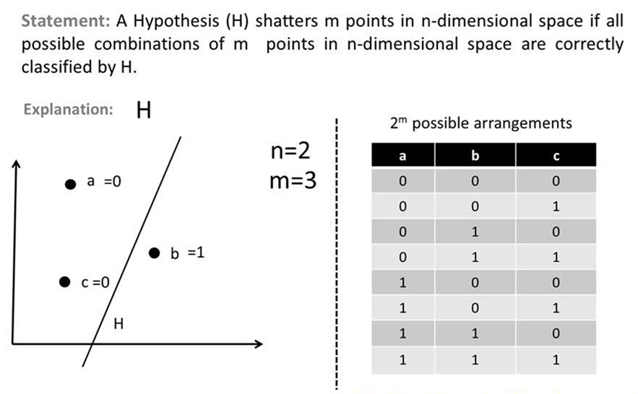

Slide 21
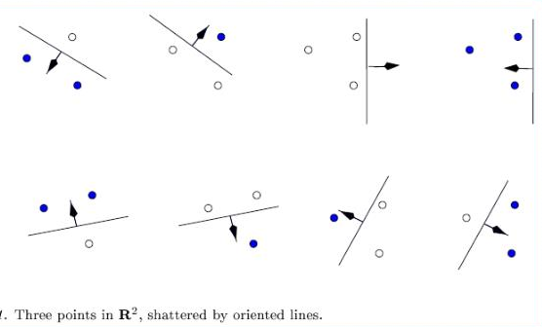

Slide 22
Continue…
An axis-aligned rectangle can shatter four points.
Only rectangles covering two points are shown
In figure, an axis-aligned rectangle that can shatter four points in two dimensions is shown.
Then VC(H), when H is the hypothesis class of axis-aligned rectangles in two dimensions, is four.
In calculating the VC dimension, it is enough that four points can be found that can be shattered;
it is not necessary that we be able to shatter any four points in two dimensions.
For example, four points placed on a line cannot be shattered by rectangles.
However, its not possible to place five points in two dimensions anywhere such that a rectangle can separate the positive and negative examples for all possible labelings.

Slide 23
Continue…
VC dimension tells that using a rectangle as a hypothesis class, learning only datasets containing four points is possible and not more, and its not very useful.
The VC dimension is a theoretical concept that cannot be directly computed from data.
However, estimation of the VC dimension for a given hypothesis set by counting the number of points that can be shattered by the set can be done.
The function takes a hypothesis set as its input and computes the VC dimension using the brute-force approach of checking all possible combinations of points and labels.
It generates all possible combinations of points and labels and then checks if the hypothesis set can shatter each combination.

Slide 24
Applications of VC – Dimension
The VC dimension has a wide range of applications in machine learning and statistics.
For example, it is used to analyze the complexity of neural networks, support vector machines, and decision trees.
The VC dimension can also be used to design new learning algorithms that are robust to noise and can generalize well to unseen data.
The VC dimension can be extended to more complex learning scenarios, such as multiclass classification and regression.
The concept of the VC dimension can also be applied to other areas of computer science, such as computational geometry and graph theory

Slide 25
Probably Approximately Correct (PAC) Learning
PAC Learning addresses the problem of learning a function from a set of samples in a way that is both probably correct and approximately correct.
PAC learning formalizes the conditions under which a learning algorithm can be expected to perform well on new unseen data after being trained on a finite set of examples.
Using the tightest rectangle, S, as hypothesis, it is required that that the hypothesis to be approximately correct
And also the hypothesis will be correct most of the time (if not always); So, the expectation is probably correct.
Probably Approximately Correct (PAC) learning, offers insights into the fundamental question of how much data is needed for learning algorithms to reliably generalize to unseen new instances

Slide 26
Continue…
The PAC learning theorem provides formal guarantees about the performance of learning algorithms.
It states that for a given accuracy (ε) and confidence (δ), there exists a sample size (N) such that any learning algorithm that returns a hypothesis consistent with the training samples will, with probability at least 1-δ, have an error rate less than ε on new data.
PAC learning is likely to make prediction on unseen data within a certain error margin
PAC learning is important because it provides a rigorous foundation for understanding the behavior and performance of learning algorithms.

Slide 27
Continue…
In PAC learning, given a class, C, and examples drawn from some unknown but fixed probability distribution, p(x), we want to find the number of examples, N, such that with probability atleast 1 − δ, the hypothesis h has error atmost (max) ε, for arbitrary δ ≤ 1/2 and ε > 0
P{CΔh ≤ ε } ≥ 1 − δ
where CΔh is the region of difference between C and h
Because S is the tightest possible rectangle, the error region between C and h = S is the sum of four rectangular strips of which one is shown shaded

Slide 28
Continue…
For any of these strips, if we can guarantee that the probability is upper bounded by ε / 4, the error is at most 4(ε /4) = ε.
Note that the overlaps in the corners are counted twice, and the total actual error in this case is less than 4(ε /4).
The probability that one of the randomly drawn positive example misses the strip is at most 1 − ε /4.
Then the probability that all N positive samples missing the strip is at most (1− ε/4)^N,
The probability that all N positive samples missing any of the four strips is at most 4(1 − ε /4)^N.
Therefore aim is to choose N such that 4(1 − ε /4)^N <= δ to achieve the goal

Slide 29
Continue…
How to choose N such that the equation is satisfied?
Consider the classic inequality function
1- x <= exp(-x)
➔ 1 - ε /4 <= exp( - ε /4 )
➔ 4 *(1 - ε /4)^N <= 4 * exp( - εN/4 ) <= δ
Dividing both sides by 4, taking (natural) log and rearranging terms, we have
N ≥ (4/ ε) log(4/δ)
Therefore, provided that we take at least (4/ε) log(4/δ) independent examples from C and use the tightest rectangle as our hypothesis h, with confidence probability at least 1 − δ, a given point will be misclassified with error probability at most ε .

Slide 30
Noise
Noise is any unwanted anomaly in the data and due to noise, the class may be more difficult to learn and zero error may be infeasible with a simple hypothesis class as shown in figure.
When there is noise, there cannot be a simple boundary between the positive and negative instances, and zero misclassification error may not be possible with a simple hypothesis.
An arbitrary closed form can be drawn by piecewise functions with a larger number of control points.

Slide 31
Continue…
There are several interpretations of noise:
There may be imprecision in recording the input attributes, which may shift the data points in the input space.
There may be errors in labeling the data points, which may relabel positive instances as negative and vice versa, which is sometimes called teacher noise.
There may be additional attributes, which not taken into account, that affect the label of an instance. Such attributes may be hidden or latent in that they may be unobservable.
The effect of these neglected attributes is thus modeled as a random component and is included in “noise.”

Slide 32
Continue…
As can be seen in figure, when there is noise, there is not a simple boundary between the positive and negative instances and to separate them, a complicated hypothesis that corresponds to a hypothesis class with larger capacity is needed.
A rectangle can be defined by four numbers/parameters, but to define a more complicated shape one needs a more complex model with a much larger number of parameters.
With a complex model, one can make a perfect fit to the data and attain zero error; like the wiggly shape in figure.
Another possibility is to keep the model simple and allow some error; the rectangle in figure.

Slide 33
Advantage of Rectangular model…
Using the simple rectangle (unless its training error is much bigger) makes more sense because of the following:
It is a simple model to use- It is easy to check whether a point is inside or outside a rectangle and can easily check, for a future data instance, whether it is a positive or a negative instance.
2. It is a simple model to train and has fewer parameters- It is easier to find the corner values of a rectangle than the control points of an arbitrary shape as a simple model is thus said to have less variance.
On the other hand, a too simple model assumes more, is more rigid, and may fail if indeed the underlying class is not that simple: A simpler model has more bias.
Finding the optimal model corresponds to minimizing both the bias and the variance.

Slide 34
Advantage of Rectangular model…
3. It is a simple model to explain - A rectangle simply corresponds to defining intervals on the two attributes.
By learning a simple model, information can be extracted from the raw data given in the training set.
4. If indeed there is mislabeling or noise in input and the actual class is really a simple model like the rectangle, then the simple rectangle, because it has less variance and is less affected by single instances, will be a better discriminator than the wiggly shape, although the simple one may make slightly more errors on the training set.

Slide 35
Occam’s razor
Given comparable empirical error, a simple (but not too simple) model would generalize better than a complex model.
This principle is known as Occam’s razor, which states that simpler explanations are more plausible and any unnecessary complexity should be removed off.
Plausible – The exponential decay is at least as strong as linear decay… as x grows, the linear function can become negative but exponential function stays positive

Slide 36
Learning Multiple Classes
In example of learning a family car, there are positive examples belonging to the class family car and the negative examples belonging to all other cars, which is a two-class problem.
In general case, there are K classes denoted as Ci, i = 1, . . . , K, and an input instance belongs to one and exactly one of them.
The training set is now of the form

Slide 37
Continue…
There are three classes: family car, sports car, and luxury sedan.
There are three hypotheses induced, each one covering the instances of one class and leaving outside the instances of the other two classes.
‘?’ are reject regions where no, or more than one, class is chosen.

Slide 38
Continue…
In machine learning for classification, the boundary separating the instances of one class from the instances of all other Classes are to be learnt.
Thus, a K-class classification problem is viewed as K two-class problems.
The training examples belonging to Ci are the positive instances of hypothesis hi and the examples of all other classes are the negative instances of hi .
Thus in a K-class problem, there are K hypotheses to learn such that
The total empirical error takes a sum over the predictions for all classes over all instances:

Slide 39
Reject
For a given x, ideally only one of hi(x), i = 1, . . . , K is 1 and a class can be chosen.
But when no, or two or more, hi(x) is 1, class cannot be chosen, and this is the case of doubt and the classifier rejects such cases.

Slide 40
Regression
Regression in Machine Learning is a supervised learning technique and is used for prediction, forecasting, time series modeling, and exploratory data analysis (determining the causal-effect relationship between variables).
There are several regression analysis techniques depending on the number of factors involved.
Regression is a statistical technique used to model and analyze the relationships between a dependent variable and one or more independent variables.
The dependent variable is what is to predict or explain, while the independent variables are the factors that might influence this prediction.
The primary goal of regression analysis is to identify the strength and character of these relationships, leading to an equation that can ultimately predict future outcomes based on new input data.

Slide 41
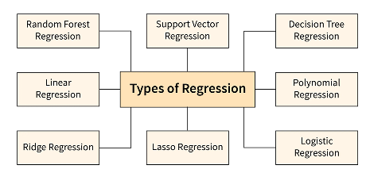
Understanding the different types of regression is crucial for effectively using this analytical tool.
Each type is suited for specific kinds of data and predictive tasks, making knowledge of these variations essential for practitioners.

Slide 42
Regression
In classification, given an input, the output that is generated is Boolean; it is a yes/no answer.
When the output is a numeric value, what to learn is not a class, C(x) ∈ {0, 1}, but is a numeric function.
In machine learning, the function is not known but we have a training set of examples drawn from it
If there is no noise, the task is interpolation.
Interpolation refers to the process of estimating unknown values that fall between known data points.
This can be useful in various scenarios, such as filling in missing values in a dataset or generating new data points to smooth out a curve.

Slide 43
We would like to find the function f (x) that passes through these points such that we have
In polynomial interpolation, given N points, we find the (N+1)st degree polynomial that we can use to predict the output for any x, which is called Extrapolation if x is outside of the range of x^{t} in the training set.
In time-series prediction, for example, there is data up to the present and the value for the future has to be predicted.
In regression, there is noise added to the output of the unknown function r^{t} = f (x^{t}) + ∈ where f (x) ∈ R is the unknown function and ∈ is random noise.
Noise is the extra hidden variables that cannot be observed r^{t} = f ∗(x^{t} , z^{t} ) where z^{t} denote those hidden variables.
We would like to approximate the output by our model g(x).

Slide 44
The empirical error on the training set X is
Because r and g(x) are numeric quantities ∈ R, there is an ordering defined on their values
The aim is to find g(·) that minimizes the empirical error.
If g(x) is assumed to be linear, then

Slide 45
Goodness of Fit: how well a sample of data fits a set of observations.
Measures of goodness of fit typically summarize the discrepancy between observed values and the values expected under the model in question
Error or loss Function: we can define a distance between values, as the square of the difference, which gives more information than equal/not equal.
The square of the difference is one error (loss) function that can be used; another is the absolute value of the difference.

Slide 46
Model Selection and Generalization
Model selection involves choosing the best model from a set of candidate models.
This process is essential because different models can have varying levels of performance on the same dataset.
Machine learning tries to find a solution to a problem but it rises to ill posed problem when the data is not sufficient to find the unique solution.
A problem is considered ill-posed if it fails to satisfy at least one of the following conditions:
existence of a solution,
uniqueness of the solution,
and continuous dependence of the solution on the initial conditions.

Slide 47
Continue…Inductive Bias
So because learning is ill-posed, and data by itself is not sufficient to find the solution, some extra assumptions have to be made to have a unique solution with the existing data.
Such set of assumptions made to have learning possible is called the Inductive bias of the learning algorithm.
One way to introduce inductive bias is when a hypothesis class H is assumed.
In learning the class of family car, there are infinitely many ways of separating the positive examples from the negative examples.
Assuming the shape of a rectangle is one inductive bias, and then the rectangle with the largest margin for example, is another inductive bias.
In linear regression, assuming a linear function is an inductive bias, and among all lines, choosing the one that minimizes squared error is another inductive bias.

Slide 48
Model Selection
Key points of Model Selection are:
Cross-Validation: This technique helps in assessing how the results of a model will generalize to an independent dataset. Common methods include k-fold cross-validation, where the dataset is divided into k subsets, and the model is trained and validated k times, each time using a different subset as the validation set and the remaining as the training set.
Hyperparameter Tuning: Models often have parameters that are not learned from the data but set initially before the training process begins. Techniques like Grid Search and Random Search are used to find the optimal hyperparameters that improve model accuracy, generalization, and efficiency.
Evaluation Metrics: Depending on the problem (classification, regression, etc.), different metrics like accuracy, precision, recall, F1-score, mean squared error, etc., are used to evaluate model performance.

Slide 49
Generalization
How well a model trained on the training set predicts the right output for new generalization instances is called generalization.
It's a measure of how well the model has learned the underlying patterns in the training data rather than just memorizing it.
Key points are:
Overfitting: This occurs when a model learns the training data too well, including the noise and outliers, leading to poor performance on new data.
Techniques to prevent overfitting include:
Regularization: Adding a penalty for larger coefficients in the model (e.g., L1, L2 regularization).
Pruning: Reducing the complexity of decision trees.
Dropout: Randomly dropping neurons during training in neural networks.

Slide 50
Underfitting: This happens when a model is too simple to capture the underlying patterns in the data, leading to poor performance on both training and new data.
Increasing model complexity or adding more features can help mitigate underfitting.
Triple Tradeoff: High bias can cause underfitting, while high variance can cause overfitting.
The goal is to find a balance where the model has low bias and low variance, achieving good generalization.
In all learning algorithms that are trained from example data, there is a trade-off between three factors:
the complexity of the hypothesis to fit to data, ie., the capacity of the hypothesis class,
the amount of training data
the generalization error on new examples.

Slide 51
As the amount of training data increases, the generalization error decreases.
As the complexity of the model class H increases, the generalization error decreases first and then starts to increase.
The generalization error of an overcomplex H can be kept in check by increasing the amount of training data but only up to a point.

Slide 52
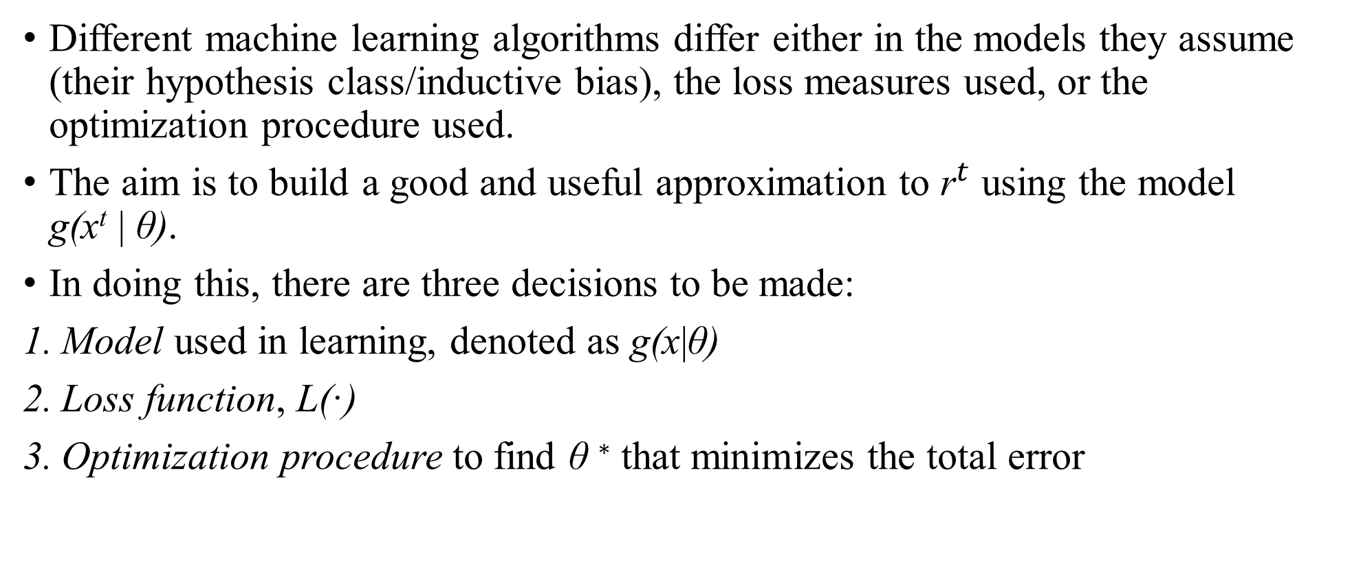
Dimensions of a Supervised ML Algorithm
Different machine learning algorithms differ either in the models they assume (their hypothesis class/inductive bias), the loss measures used, or the optimization procedure used.
The aim is to build a good and useful approximation to ${\text{r}}^{t}$ using the model g(x^{t} | θ).
In doing this, there are three decisions to be made:
Model used in learning, denoted as g(x|θ)
Loss function, L(·)
Optimization procedure to find θ ∗ that minimizes the total error

Slide 53
Model used in learning, denoted as g(x | θ) where g(·) is the model, x is the input, and θ are the parameters.
g(·) defines the hypothesis class H, and a particular value of θ instantiates one hypothesis h ∈ H.
For example, in class learning, a rectangle is taken as the model whose four coordinates make up θ ;
The model (inductive bias), or H, is fixed by the machine learning system designer based on his or her knowledge of the application and the hypothesis h is chosen (parameters are tuned) by a learning algorithm using the training set, sampled from p(x, r).

Slide 54
2. Loss function, L(·), to compute the difference between the desired output- r^{t} and approximation to it, g(x^{t} | θ), given the current value of the parameters, θ.
The approximation error, or loss, is the sum of losses over the individual instances
In class learning where outputs are 0/1, L(·) checks for equality or not;
In regression, because the output is a numeric value, and there is ordering information for distance, one possibility is to use the square of the difference.

Slide 55
3. Optimization procedure to find θ∗ that minimizes the total error
where argmin returns the argument that minimizes.
With more complex models and error functions, use more complex optimization methods, for example, gradient-based methods, simulated annealing, or genetic algorithms.

Slide 56
Thank You

